Slide 1
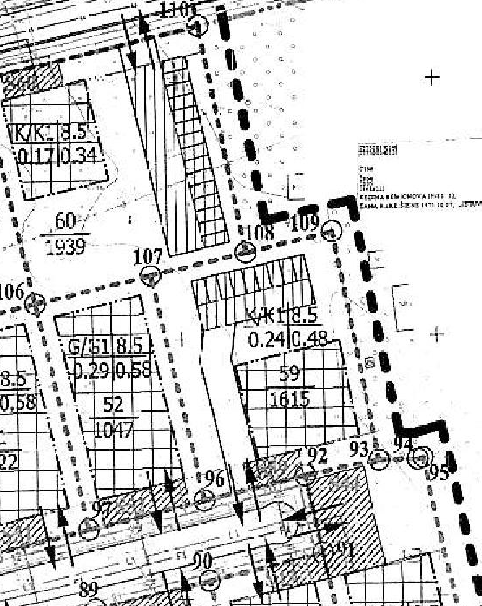
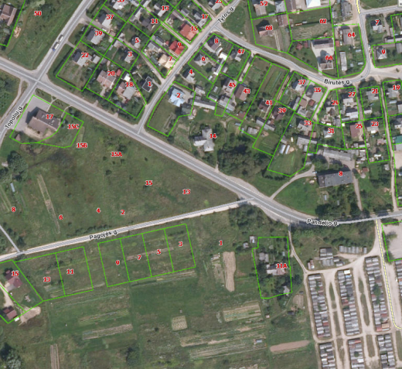

Commercial Land
Rokiskis District Municipality Administration
Plan of the land Photo of the land
Address | Rokiskis town, PAGOJĖS str.1A
Lot size | 0,1615 Ha
Electricity | 80m distance to substation of power system
Water | 50 m, d100 mm distance to water network
Telecommunications | 40 m distance to internet, telephone network
Distance to the main road | 0,04Km
Price/other conditions | Has not offerred for sale at an auction Detailed plan has prepared Land is commercial

